Slide 1
Methane Oxidation in Serpentinization-Hosted Ecosystems
Taylor Walton
Alta Howells, Michelle Santana, Everett Shock
Notes:
Limit 7-8 minutes, 2-3 minutes questions

Slide 2
Culture Dependent Approach: Test Predictions from Environmental Observations
Observations
Geochemistry
Environment
Biology
Predictions
Culture Experiments
Notes:
The environment, which is influenced by both geochemistry and biology, generates observations. From there we generate predictions, and then experiments

Slide 3
Serpentinization in the Oman Samail Ophiolite
Mixing = Disequilibrium
Energy for…
CH₄ + 2O₂ → CO₂ + 2H₂O
Aerobic Methane Oxidation
(Methanotrophs)
Notes:
(serpentine thought to be a common process throughout ocean worlds due to rock type involved)
From subsurface water-rock reactions, a hyperalkalne fluid is generated
Fluid mixes with surface water
This fluid is in disequilibria with the atmosphere
This indicates that there is potential energy for methanotrophs

Slide 4
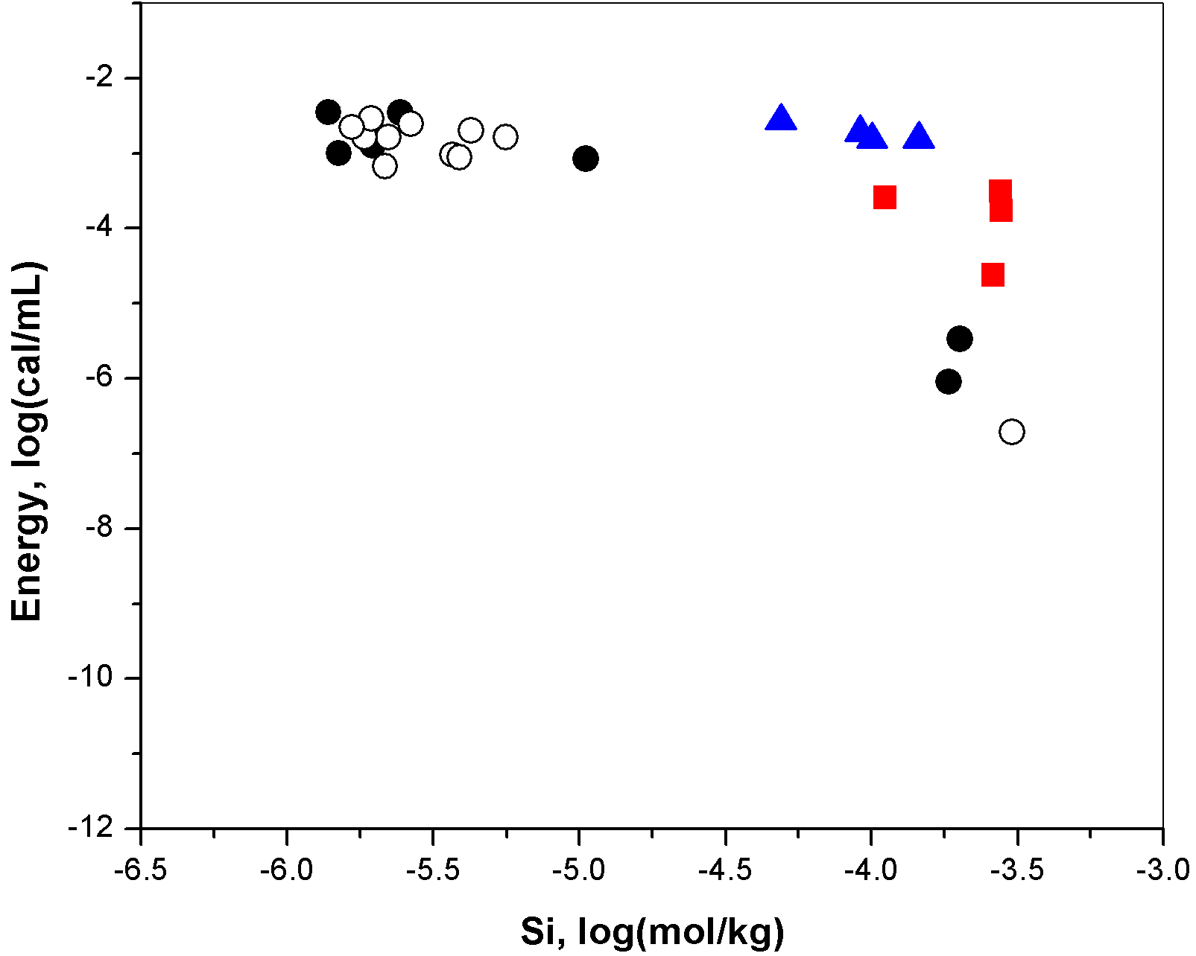
Energy available, are methanotrophs present? 16S rRNA Gene Analysis
CH₄ + 2O₂ → CO₂ + 2H₂O
Notes:
Energy is available,
Silica is used as an indicator of mixing
But methanotrophs are not present everywhere
Abundance varies across a mixing gradient
There could be other environmental factors affecting abundance

Slide 5
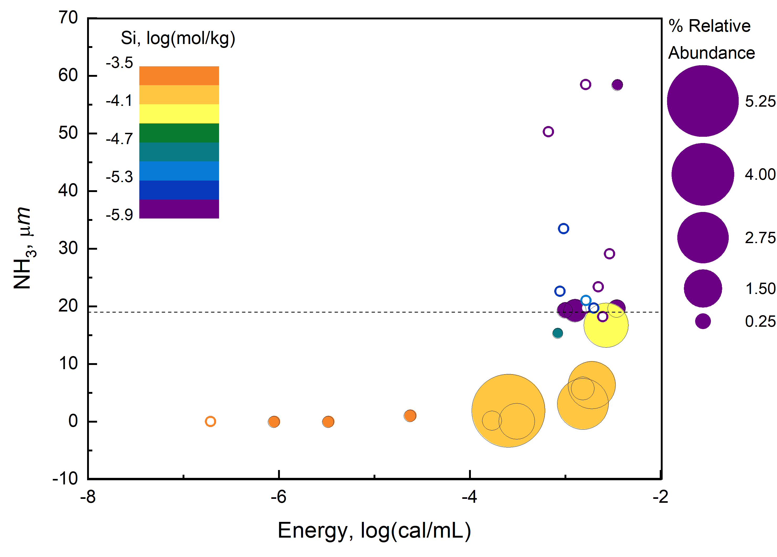
Geochemical Drivers on Distribution of Methanotrophs Our Prediction, Competitive Inhibition by NH₃
Presence/absence plot of 16S rRNA genes. ,16S rRNA gene is not present. , 16S rRNA gene present.
Energetic Model
Notes:
One environmental factor affecting pH is [NH₃]
Our system is right on the brink of having too much ~20 um
From this we predict that as [NH₃] increases, the ability of methanotrophs to grow decreases

Slide 6
Culture Dependent Approach
To Test Hypothesis
Inoculate media designed from environmental geochemistry, ~20% O₂, ~5% CH₄ headspace, pH 11.4, 34˚C
Vary [NH₃]
Environmental concentration
NH₃ replete
NH₃ deplete
Evaluate growth of methanotrophs
CH₄ consumption
16S rRNA gene analysis
Calculate methane oxidation rate
Rate
Test hypothesis: Compare rate to [NH₃]
NH₃, μm
Notes:
media influenced by environment
pH is upper limits of methanotrophy (omit)
Building experiment to test [NH₃] concentrations over time
If asked: yes, did a replete experiment in fall, but had to redesign once we discovered too little [O₂]
If CH4 consumed expect graph
Also expect + DNA results
Then show negative correlation with [NH₃]

Slide 7
Results from Environmental [NH₃] Experiment
No significant decrease in methane over 72 days

Slide 8
Environment to Enrichment Community Change 16S rRNA Gene Sequencing
Notes:
The data can also show how the overall community changes over time
Initial loss of diversity
But then we see an increase in day 16 relative to day 6
Then, we focus on populations

Slide 9
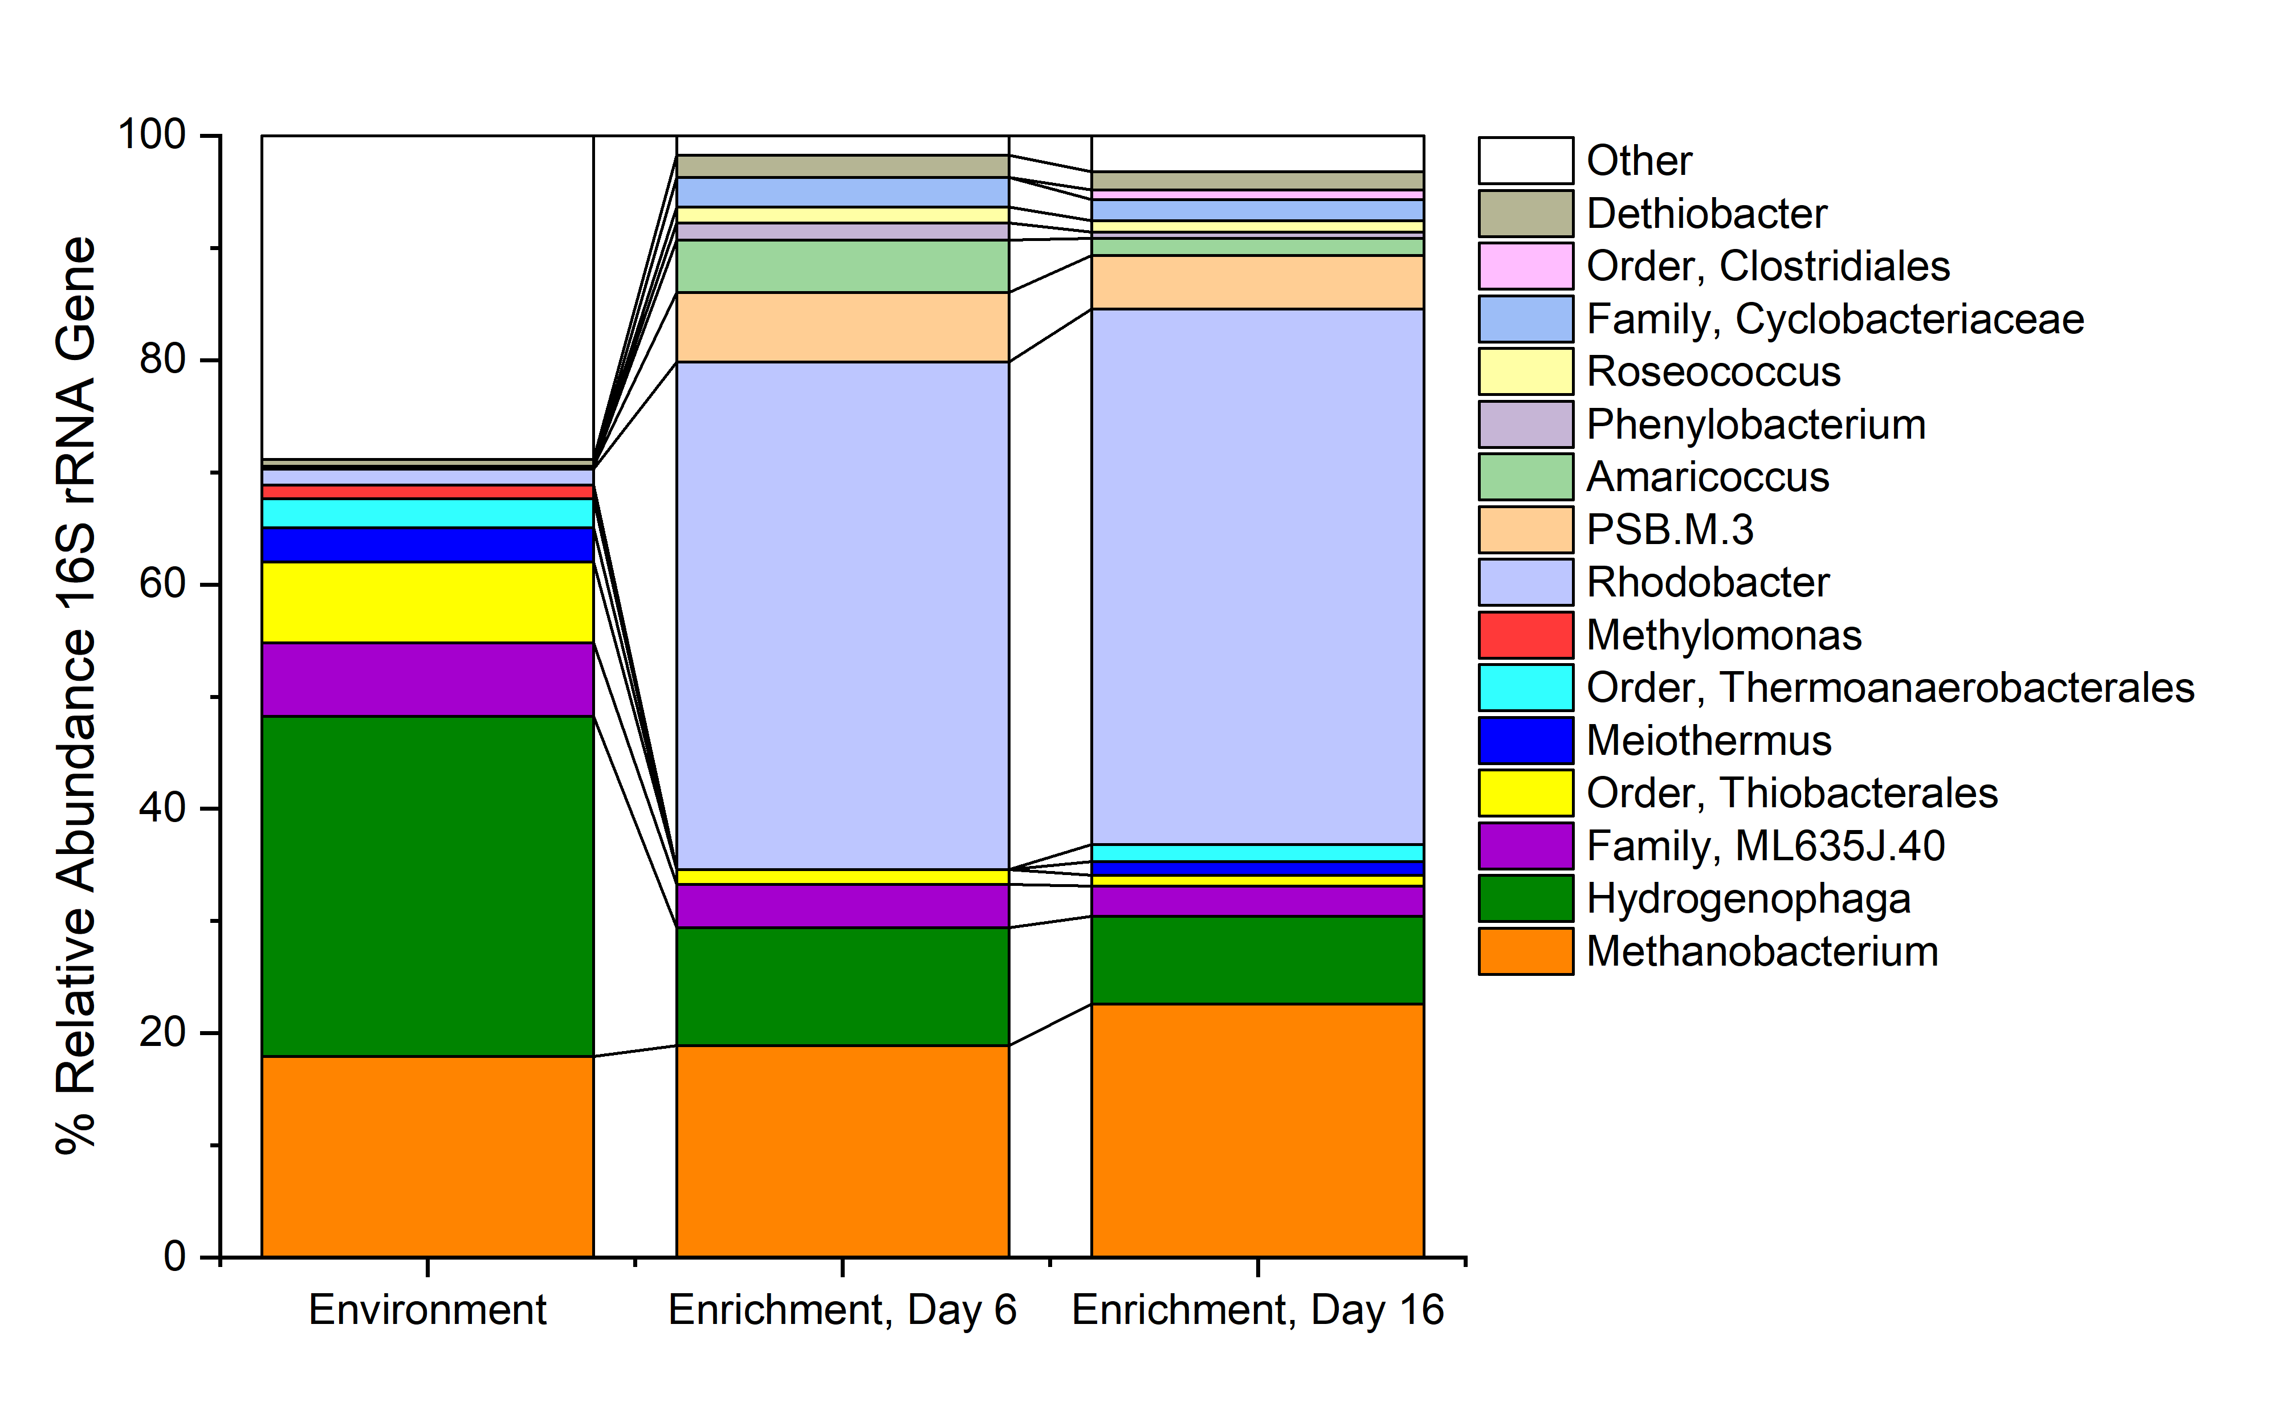
Populations Selected for and Against Environment to Culture
Notes:
Methylomonas, the methanotrophs, is not seen in day 6 or 16 data
The methanotrophs, methanobacterium, remain relatively stable throughout
Hydrogenophaga, a hydrogen oxidizer, is selected against
However, rhodobacter, a non-sulfur purple photoheterotroph (explain), greatly enriched
Other smaller. Rare microbial populations initially selected for befroe decreases

Slide 10
Early conclusions and future work
Influence of NH₃ methanotroph growth
From these preliminary results, environmental [NH₃] inhibits growth of methanotrophs in culture
Alternatively, methanotrophs could be slow growers, and longer observation is required
Community response
Diversity changes
Rhodobacter, as photo-heterotroph greatly enriched
Methanogens still present in the culture
Next steps
Continue monitoring community growth of environment [NH₃] experiment
Continue CH₄ measurements
16S rRNA gene sequencing on all time points
Run replete/deplete NH₃ experiments
Week 1
2
3
4
5
2018
Today

Slide 11
Acknowledgements
ASU/NASA Space Grant
GEOPIG research group
Alta Howells, Michelle Santana, Everett shock
Rock Powered Life

